Slide 1
IE Organizational Building Leadership Program
Session 4: Traits of Highly Effective Organizations
September 19, 2024
Dr. Gabbie Aquino-Adriatico
Research Fellow
Research and Social Impact Department

Slide 2

General Reflections on Last Session
Notes:
Share in chat or unmute and share
Nonprofit Landscape (IE: by revenue by sector, challenges facing np orgs, revenue by region)
Core pillars of NPs: Strategic Vision & Planning / Resource Management & Sustainability / Mission-Driven Leadership & Culture / Stakeholder Engagement & Advocacy)
Leadership vs Management / Changing paradigms of leadership
Delegating, Supporting, Coaching, Directing
Grounded leader: Six Disciplines – Physical, Emotional, Intellectual, Social, Vocational, Spiritual
Leadership Manifesto handout

Slide 3
Group Agreements
Be present
Participate – interaction
Step up/back
Listen without judgement
Share the message, not the messenger
Talk from your experience
Be open to new ideas
Learn from each other
Be respectful with electronics

Slide 4
Session 4 - Dr. Gabbie Aquino-Adriatico
Dr. Gabbie Aquino-Adriatico
Research Fellow
Research and Social Impact Department
Gaquino@cnmsocal.org
Notes:
Facilitator Intro

Slide 5
Agenda
Welcome and Check In
Introduction
Traits of Highly Effective Organizations
Examples of Organizational Assessments
SWOT Practice Activity
Resources
Q&A

Slide 6

Learning Objectives
1. Leaders will be able to identify traits for effective organizations.
2. Leaders will learn tools on how to assess their organizations for effectiveness.
3. Leaders will be able to network with other cohort-mates and learn from one another.

Slide 7
Introduction

Slide 8
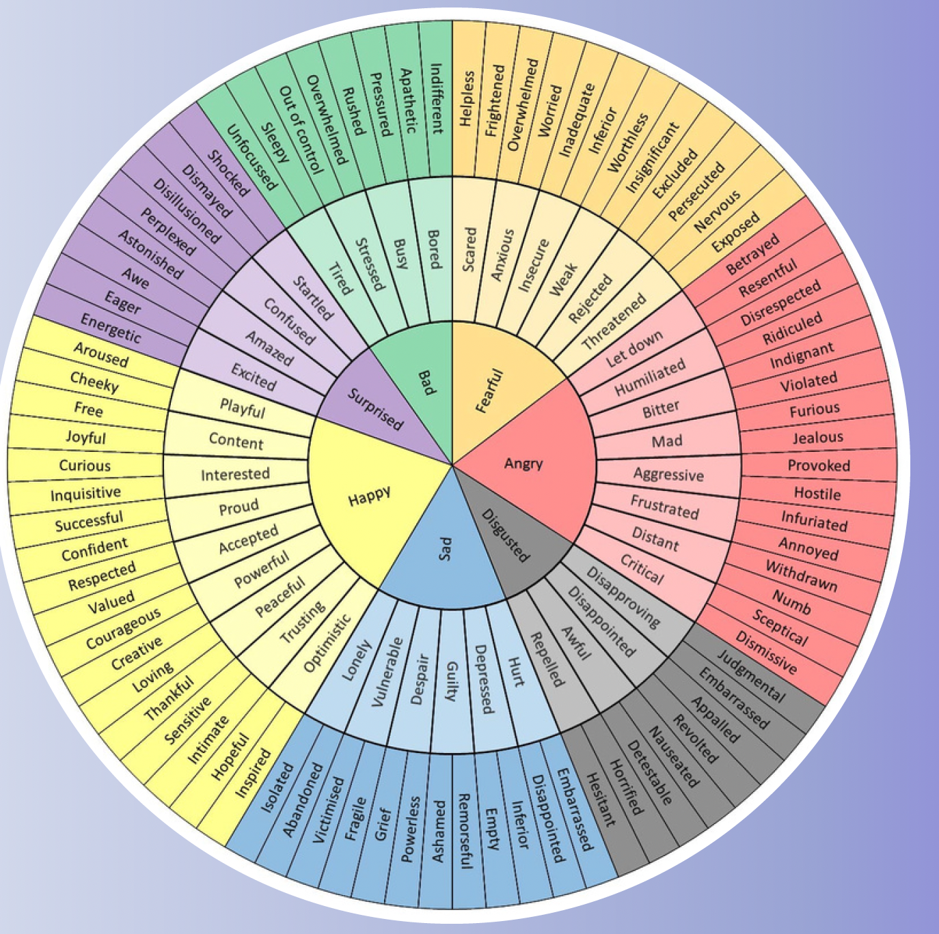
Introduction
In the chat box…
Please share your:
Name
Pronouns
Organization
Job Title
How are you feeling today?

Slide 9
Review of Past Workshops
Fostering Organizations and Individual Resiliency
Defining Leadership for 2024 and Beyond
Leveraging Your Identity as a Leader

Slide 10
Traits of Effective Organizations

Slide 11
Activity
Go to: http://tiny.cc/EdisonIEJamboard
What makes an organization effective?
What are traits of effective organizations?
Notes:
Jamboard: https://jamboard.google.com/d/1cPMXX5JRZp73e__e2T7hfO6AWa4wWFv92Q1VSD26FXo/edit?usp=sharing
Go to: http://tiny.cc/EdisonIEJamboard
What makes an organization effective?
What are traits of effective organizations?

Slide 12
15 Traits (Ford Foundation, 2023)
Mission and Strategy
Programming
Learning and Evaluation
Advocacy
Field Engagement
Membership
External Communications
Human Resources
Organizational Culture
Governance
Financial Management
Fundraising and Donor Relations
Administration
Safety and Security
Executive Leadership

Slide 13
Individual Organizational Assessments

Slide 14
Organizational Assessments
Assessments are tools you can use to identify areas of growth and strengths within an organization.
It’s not a one size fit all.
There are validated measures.
Consider the context of your organization.
Determine what you want to assess.

Slide 15
What assessments have you used in your organization?
Notes:
In the chat...What assessments have you used in your organization?

Slide 16
Examples of Organizational Assessments
Ford Foundation’s Organizational Mapping Tool (OMT)
SWOT Analysis
AmeriCorp’s Organizational Capacity Tool (OCT)
Advancing Partners & Communities Organizational Capacity Assessment (OCA)

Slide 17
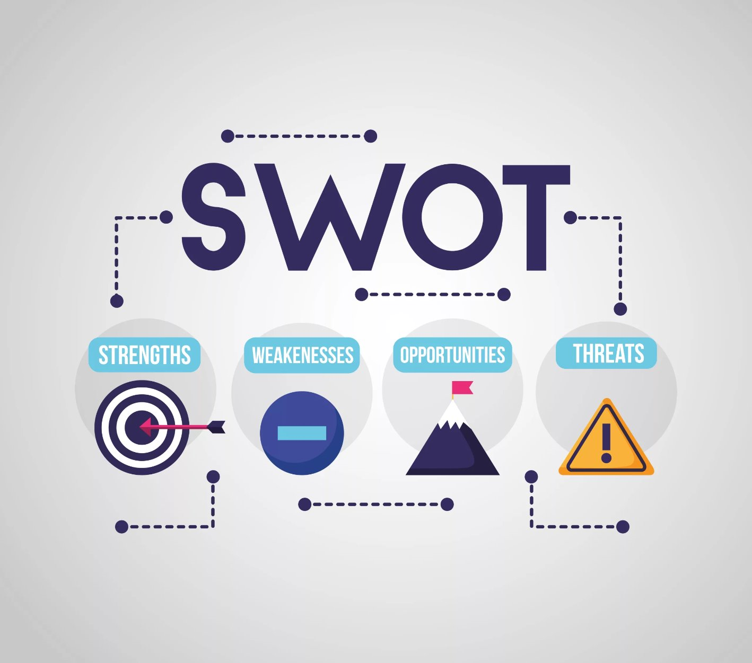

Slide 18

Notes:
Video link: https://www.youtube.com/watch?v=Ath_K1OuPzw

Slide 19
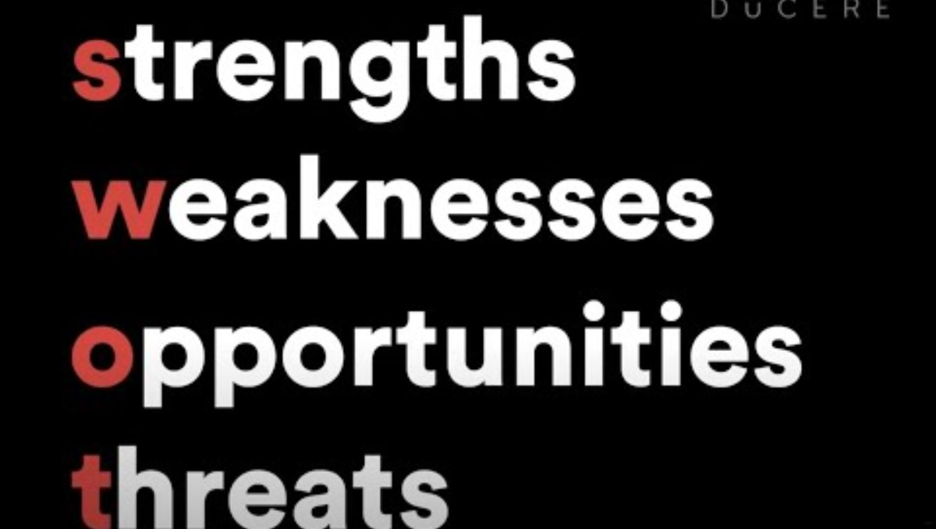
Notes:
Video link: https://www.youtube.com/watch?v=pUTZ6NOWeYs

Slide 20
Strengths
What are your organization's internal strengths?
Weaknesses
Opportunities
These strengths are building blocks for your strategies.
Where can your organization improve?
Examples: lack of funding, high turnover in staff, minimal online presence, etc.
External opportunities: growing need for your services, new technologies to enhance work, partnerships with other organizations, new funding opportunities, changes in policy related to your work
Threats
Can negatively affect your organization
Examples: cuts to funding, increased competition in your sector, misinformation
Internal
External

Slide 21
SWOT Practice Activity

Slide 22
Organization Case Study
An nonprofit organization is struggling with financial and capacity strengthening.
The organization has two major grants that are finishing up in the next two years, which poses a risk for losing staff when they are already short-staffed.
The leader is looking for other funding opportunities through grants.
Through networking with other organizations in the sector, the leader learned that there are other alternative funding sources they can apply for such as private donations and fundraising.
This organization has a great reputation in the community and is known for its willingness to collaborate.
Notes:
Org case study: An nonprofit organization is struggling with financial and capacity strengthening.
The organization has two major grants that are finishing up in the next two years, which poses a risk for losing staff when they are already short-staffed.
The leader is looking for other funding opportunities through grants.
Through networking with other organizations in the sector, the leader learned that there are other alternative funding sources they can apply for such as private donations and fundraising.
This organization has a great reputation in the community and is known for its willingness to collaborate.

Slide 23

Practice SWOT with Your Organization
Join your breakout room.
Conduct a SWOT analysis for the organization case study.
We will share out in the big group if there is time.
Ideas for SWOT:
Assess traits of the organization.
Identify strategies to grow a trait.

Slide 24
Can you use a SWOT analysis in your organization? If so, how?
Notes:
In the chat, please answer...Can you use a SWOT analysis in your organization? If so, how?

Slide 25
Resources

Slide 26
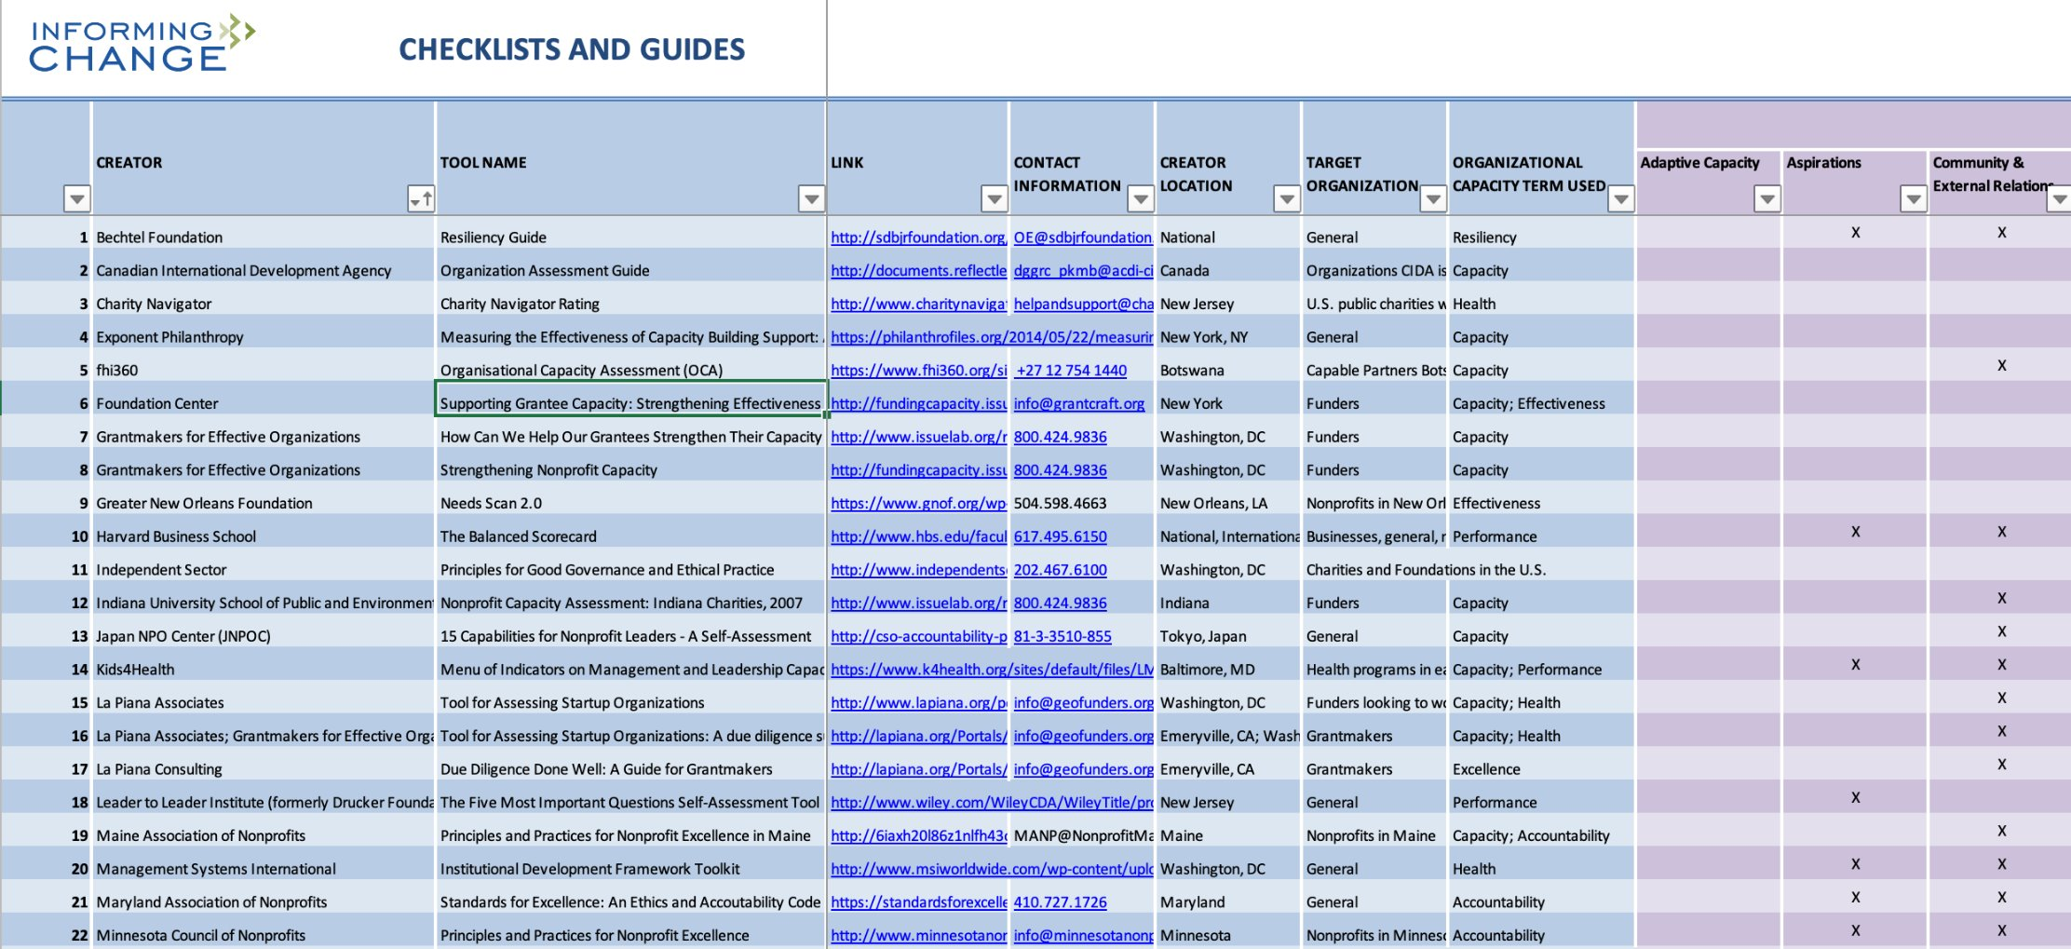
Organization Capacity Assessment Tool Database (2017)

Slide 27
Other Resources
https://hewlett.org/wp-content/uploads/2017/11/A-Guide-to-Using-OCA-Tools.pdf
https://management.org/organizationalperformance/nonprofits/index.htm
https://hbr.org/2022/08/10-principles-of-effective-organizations
https://www.racialequitytools.org/resources/plan/informing-the-plan/organizational-assessment-tools-and-resources
https://www.leanvlog.com/swot-analysis-explained/

Slide 28
What is one thing you learned today?
Notes:
Please type it in the chat...What is one thing you learned today?

Slide 29
Q & A

Slide 30
References
Ford Foundation. (2023). Organizational mapping tool. Ford Foundation. https://www.fordfoundation.org/work/our-grants/building-institutions-and-networks/organizational-mapping-tool/
Helms, M. M., & Nixon, J. (2010). Exploring SWOT analysis–where are we now? A review of academic research from the last decade. Journal of strategy and management, 3(3), 215-251.
Sammut‐Bonnici, T., & Galea, D. (2015). SWOT analysis. Wiley Encyclopedia of management, 1-8.
The University of Kansas. (2024). Organizational Assessments. https://humanresources.ku.edu/organizational-assessments

Slide 31

Notes:
Please type it in the chat...What is one thing you learned today?

Slide 32
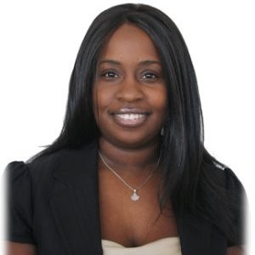
Tremaine Mitchell
Executive Director
Youth Action Project (YAP)
Fireside Chat with Tremaine Mitchell
Notes:
Cedars WelcomeAs co-founder and Executive Director of Youth Action Project, Tremaine Mitchell is guided by its mission to improve communities through the training and development of youth and young adults. Mrs. Mitchell is a seasoned helping professional with over two decades of success in the development of programs, systems, and people. Through her experience as a social worker, nonprofit leader, and certified master coach, Mrs. Mitchell has helped hundreds of individuals achieve their personal and professional development goals.

Slide 33
Upcoming Sessions

Slide 34
Date | Session Topic
Oct 10 (In-Person) | Implementing Succession Planning for Sustainable Organizations

Slide 35
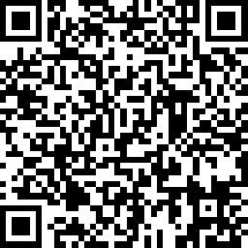

Please complete our seminar evaluation
Session Four: Traits of Highly Effective Organizations
Main Instructor: Dr. Gabbie Aquino-Adriatico
35

